Slide 1
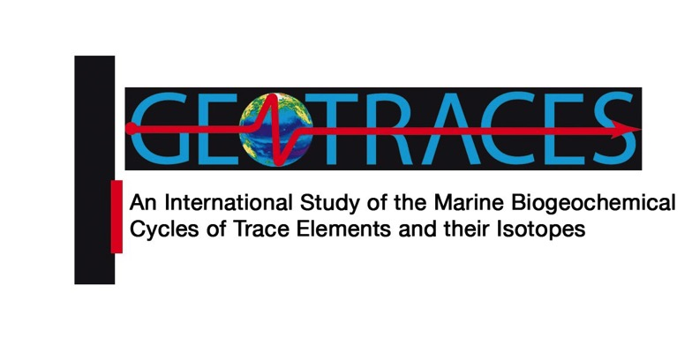

Slide 2
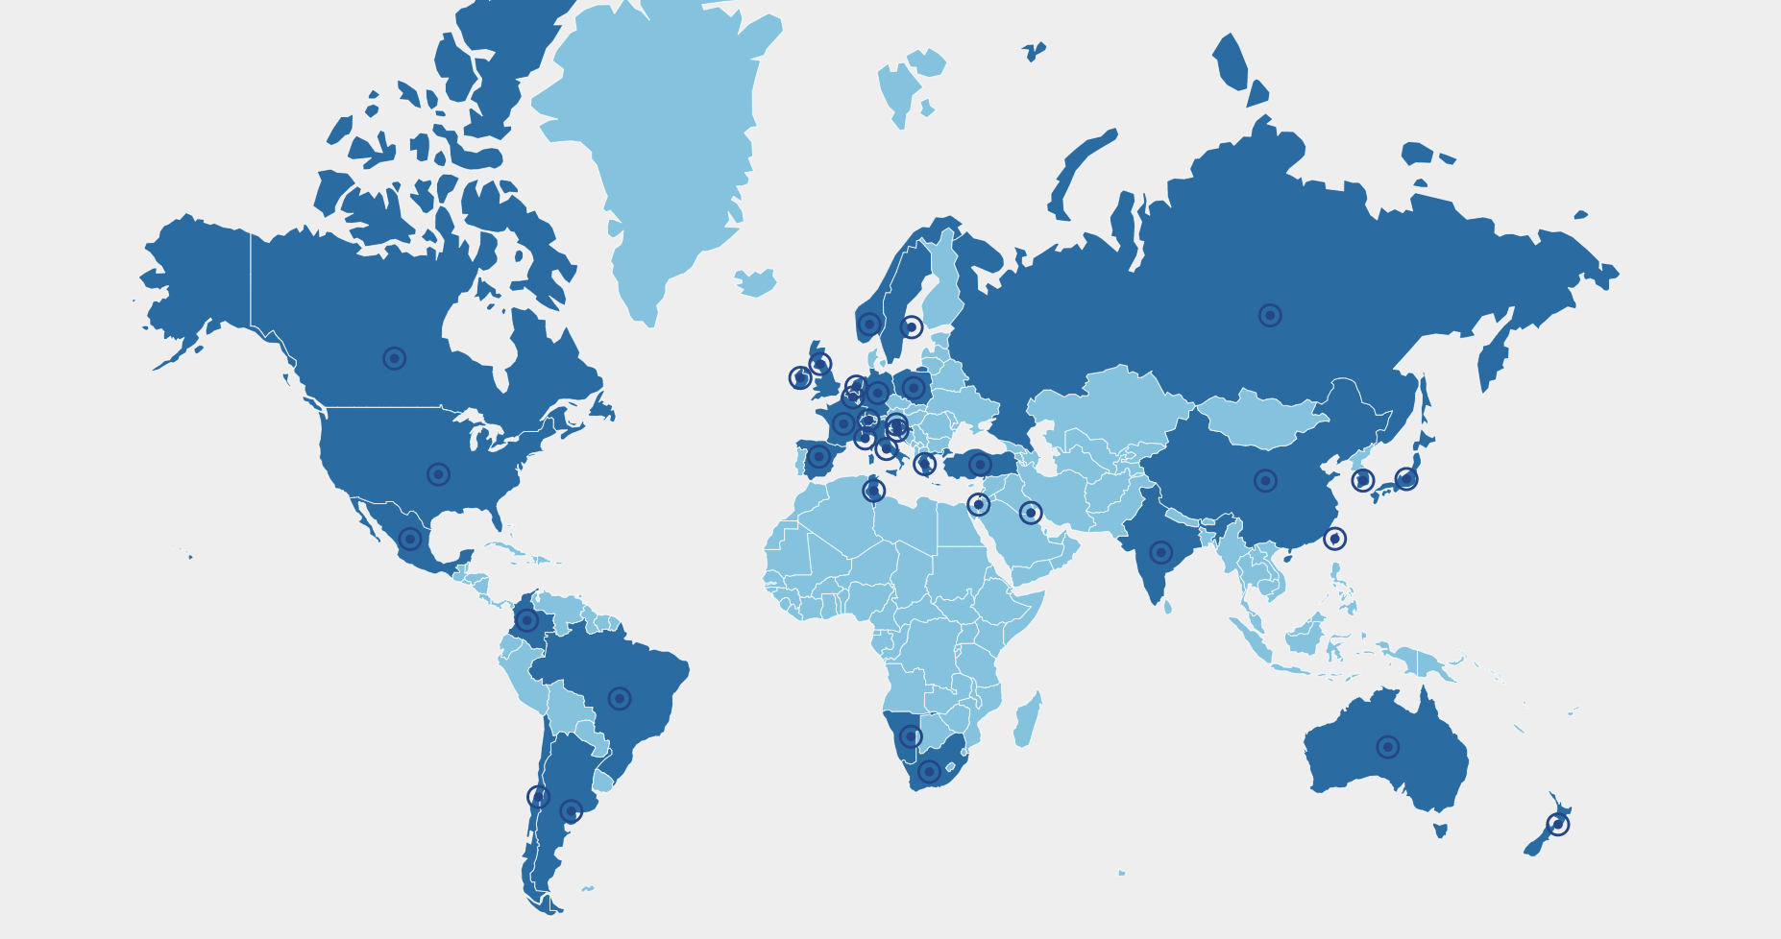
GEOTRACES mission
GEOTRACES mission is to identify processes and quantify fluxes that control the distributions of key trace elements and isotopes (TEIs) in the ocean, and to establish the sensitivity of these distributions to changing environmental conditions
Scientists from more than 35 nations have been involved in the programme, which is designed to study all major ocean basins
Co-chairs: Karen Casciotti (University of Stanford, USA) Maeve Lohan (University of Southampton, UK)

Slide 3
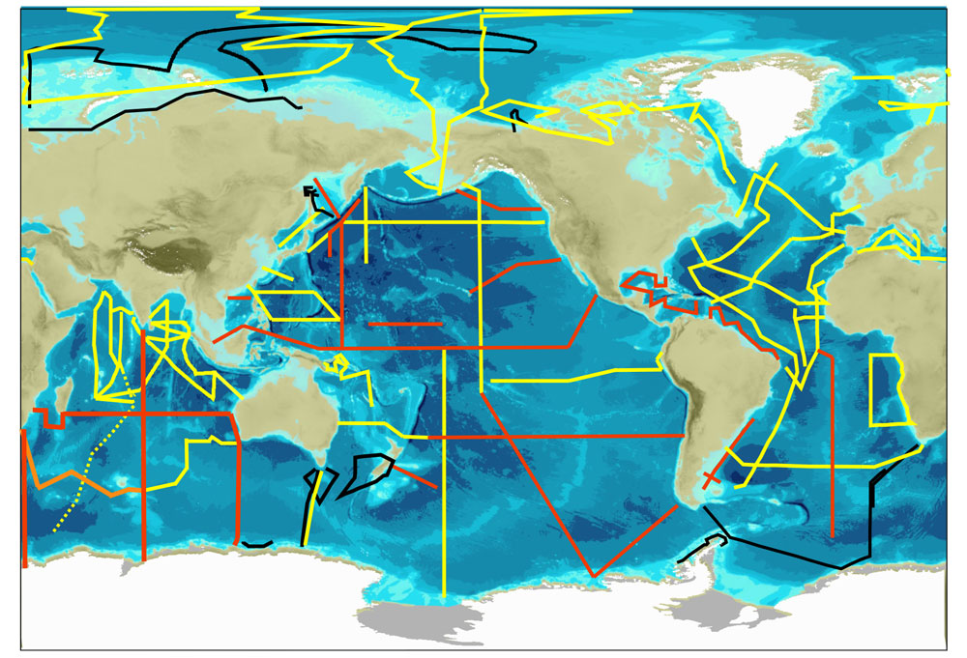
GEOTRACES presentation card
To date:
35 nations
130 cruises completed (+10 completed during the reporting period)
43 sections completed (+1 completed during the reporting period, in orange) 1,688 publications
Data Products in 2014 and 2017
New data product forthcoming in Nov21
Map legend: Map of GEOTRACES sections. In red: Planned Sections. In yellow: Completed Sections. In orange: Section completed during the reporting period. In black: Sections completed as GEOTRACES contribution to the IPY.

Slide 4
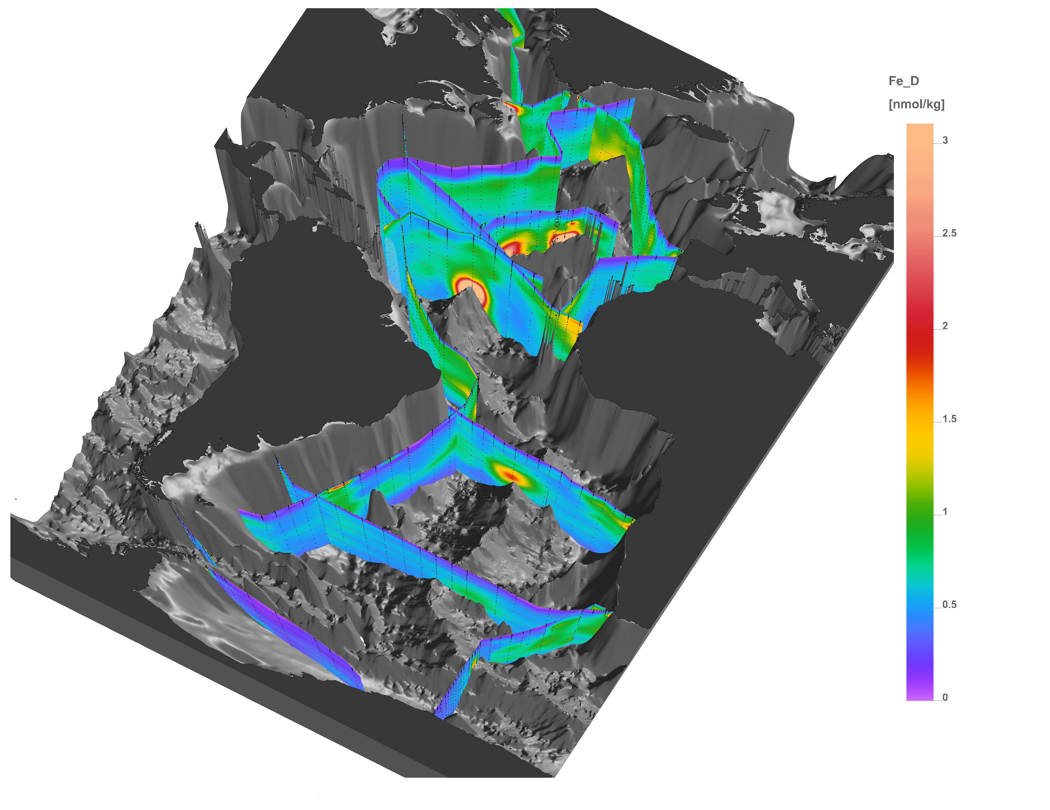
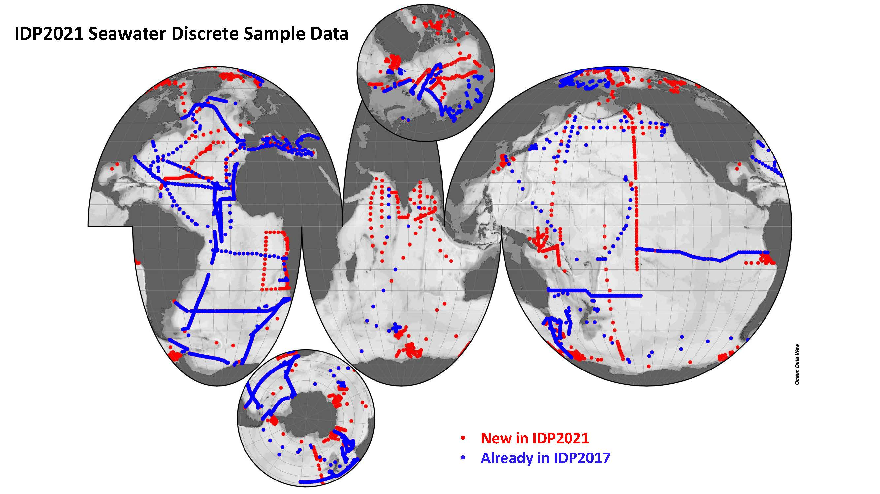
GEOTRACES Intermediate Data Product
New GEOTRACES Intermediate Data Product 2021!
Just published (17 November)!
IDP2021 consists on:
Freely available on-line!
Thanks to 350 data contributors!
(1) a compilation of digital trace metal data 100,000 samples from 77 cruises (geotraces.org/dp) | (2) the eGEOTRACES Electronic Atlas (egeotraces.org)
Data available in 3 formats: csv ASCII, NetCDF and as Ocean Data View collections. Analysis, exploration and visualisation without download possible thanks to the web ODV tool (https://geotraces.webodv.awi.de/)
Dissolved Fe in the Atlantic Ocean

Slide 5
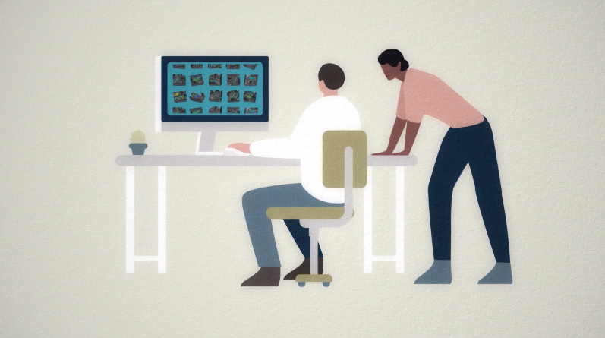
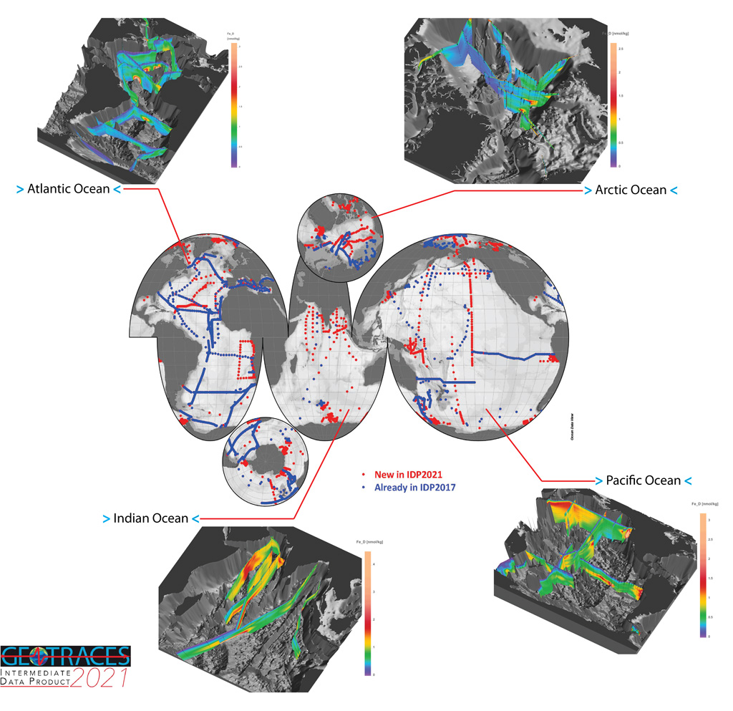
GEOTRACES Intermediate Data Product
Just published!
New GEOTRACES Intermediate Data Product, IDP2021!
www.bodc.ac.uk/geotraces/data/dp
Freely available on-line!
Thanks to 350 data contributors!
Released on 17 November. View video of the release event: https://youtu.be/bgaQUHZFJtc
What does IDP2021 include and how can be accessed? View video:
https://youtu.be/j3mjfh-RSjU

Slide 6
GEOTRACES Intermediate Data Product
IDP2021 consists on:
(1) a compilation of digital trace metal data 100,000 samples from 77 cruises (geotraces.org/dp) | (2) the eGEOTRACES Electronic Atlas (egeotraces.org)
Data available in 3 formats: csv ASCII, NetCDF and as Ocean Data View collections. Analysis, exploration and visualisation without download possible thanks to the web ODV tool (https://geotraces.webodv.awi.de/)
Dissolved Fe in the Atlantic Ocean

Slide 7
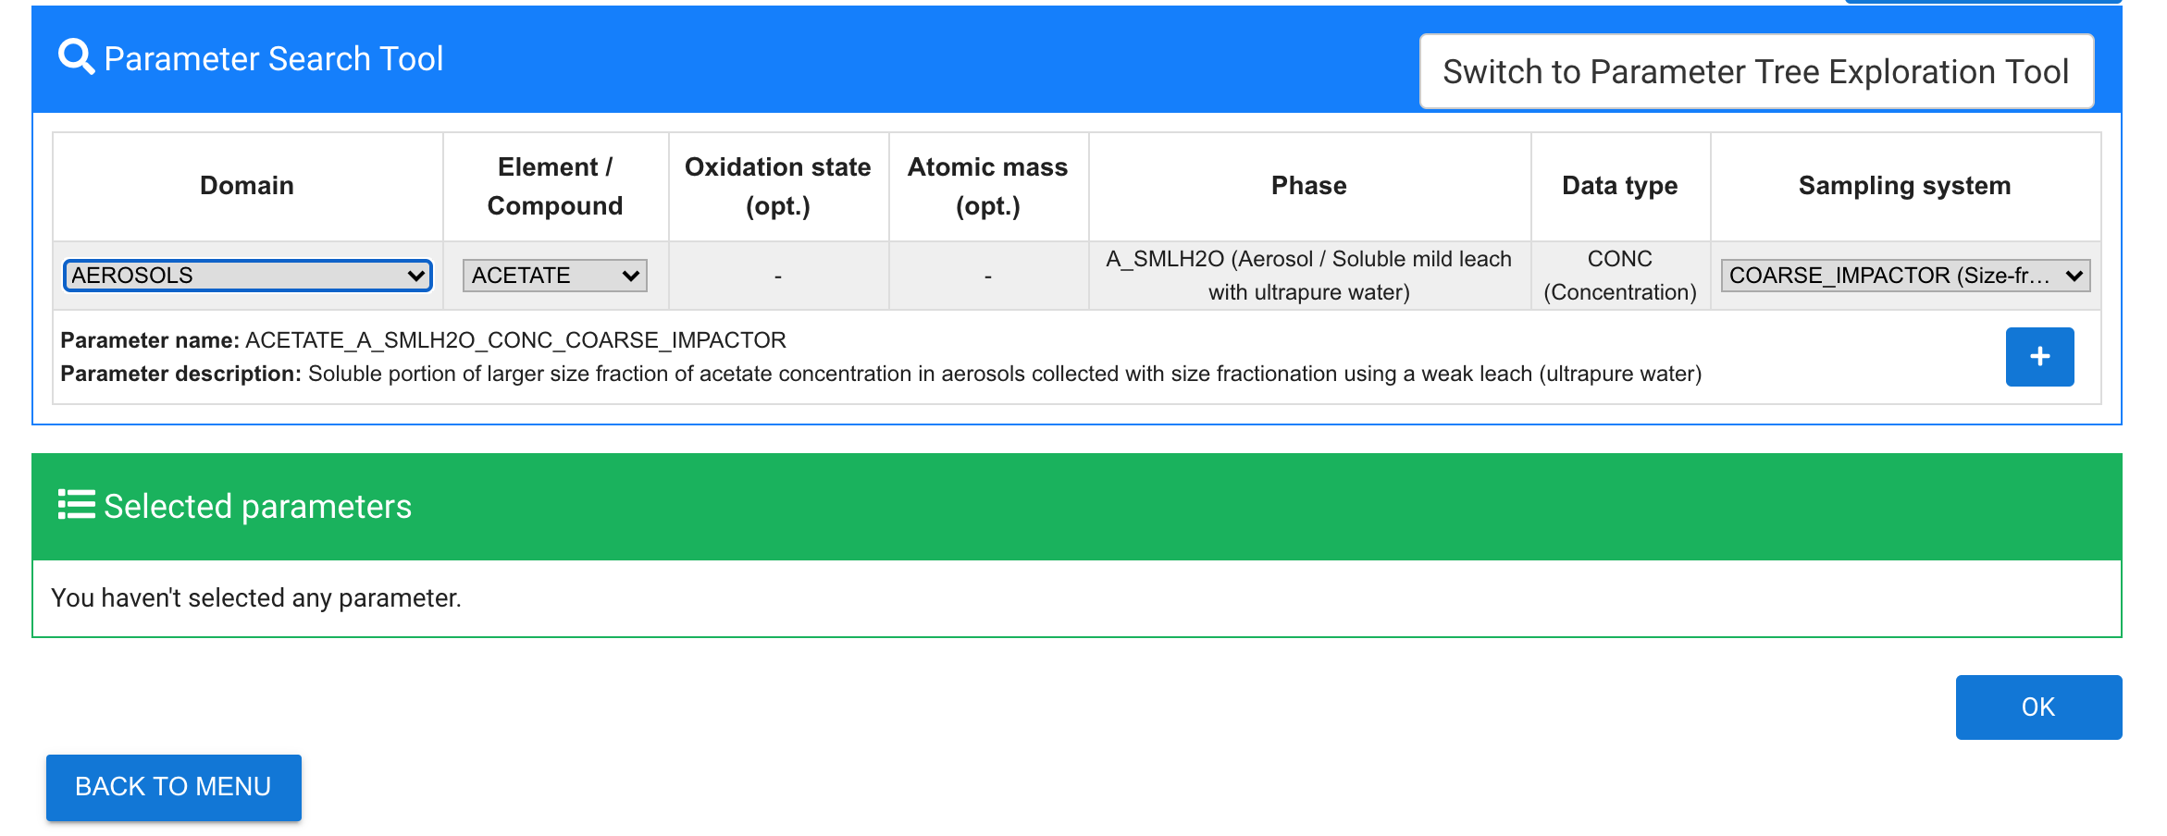
GEOTRACES Data for Oceanic Research (DOoR)
Dedicated on-line portal to register data sets for intercalibration and potential inclusion in IDP2021, generate templates for data submission and provide necessary metadata for the building of the IDP2021.
Management tool for GEOTRACES subcommittees and the GEOTRACES Data Centre to work on the preparation of the IDP2021.
https://geotraces-portal.sedoo.fr/pi/

Slide 8
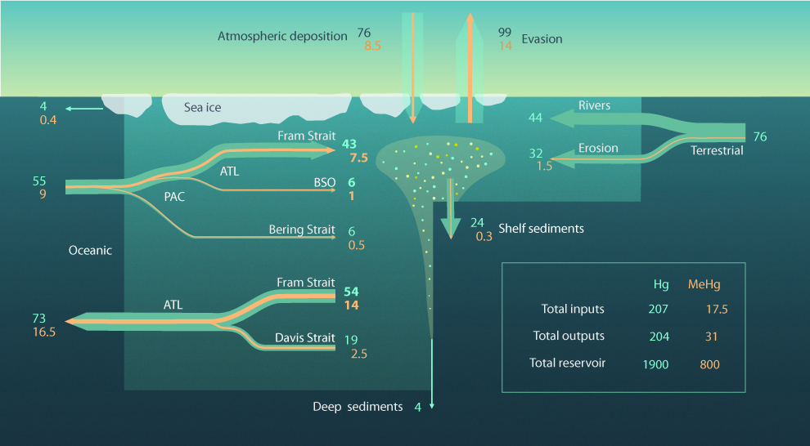
Precise estimate of the mercury export from the Arctic to the Atlantic Ocean
Using new observations acquired during several GEOTRACES cruises a refined arctic Hg budget was established.
The Hg concentrations in the East Greenland Current (EGS 1.29 ± 0.43 pM) were higher, compared to the West Spitsbergen Current (WSC 0.80 ± 0.26 pM), resulting in a northward flow of 43±9 Mg y−1 and a southward flow of 54±13 Mg y−1 at Fram Strait.
The updated arctic Hg mass balance shows that the Arctic Ocean exports about 18 Mg y−1 Hg to the Atlantic Ocean, 40% of which is in the form of methylmercury.
Reference:
Petrova, M. V.; Krisch, S.; Lodeiro, P.; Valk, O.; Dufour, A.; Rijkenberg, M. J. A.; Achterberg, E. P.; Rabe, B.; van der Loeff, M. R.; Hamelin, B.; Sonke, J.E., Garnier, C.; Heimbürger-Boavida, L.E. Mercury Species Export from the Arctic to the Atlantic Ocean. Mar. Chem. 2020, 103855.
DOI: https://doi.org/10.1016/j.marchem.2020.103855
Notes:
Figure: Updated Arctic Mercury Budget. Using the new numbers at Fram Strait (bold) and those of previous studies an updated Arctic mercury and methylmercury budget is developed. Fluxes in Mg/y and reservoirs in Mg.

Slide 9
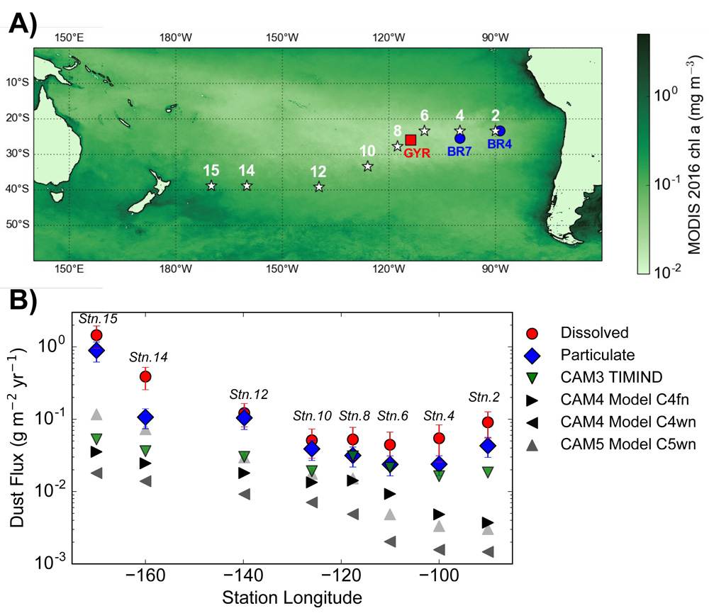
Surface water trace element and isotope data challenge dust flux models
Using measurements of dissolved and particulate thorium-230 (230Th) and thorium-232 (232Th) along a section across the South Pacific authors estimated the dust flux over this remote area.
Although the calculated dust input rates stand among the lowest ever determined, they are 1–2 orders of magnitude higher than those estimated by global dust models.
Using published dissolved iron (Fe) data, Fe/232Th ratios and solubility of these tracers in aerosols, the authors also estimated the dust-borne Fe flux over the South Pacific Gyre (SPG).
They reveal that in contrast to previous studies, atmospheric deposition and not the physical transport, is the most important process supplying Fe to phytoplankton at the surface of the SPG.
Pavia, F. J., Anderson, R. F., Winckler, G., & Fleisher, M. Q. (2020). Atmospheric Dust Inputs, Iron Cycling, and Biogeochemical Connections in the South Pacific Ocean From Thorium Isotopes. Global Biogeochemical Cycles, 34(9).
DOI: https://doi.org/10.1029/2020GB006562
Notes:
Figure: Study area and dust flux results from Pavia et al. 2020. Panel A) shows the locations of the sampling stations in this study as stars, with the sampling locations of previous studies that measured dissolved iron shown as either dots or squares. The colormap shows MODIS satellite estimates of chlorophyll a concentrations at the sea surface. Panel B) shows the dust flux estimates from dissolved (red circles) and particulate (blue diamonds) thorium isotope based methods measured in this study, while the dust flux estimates from global atmospheric models are shown as triangles.

Slide 10
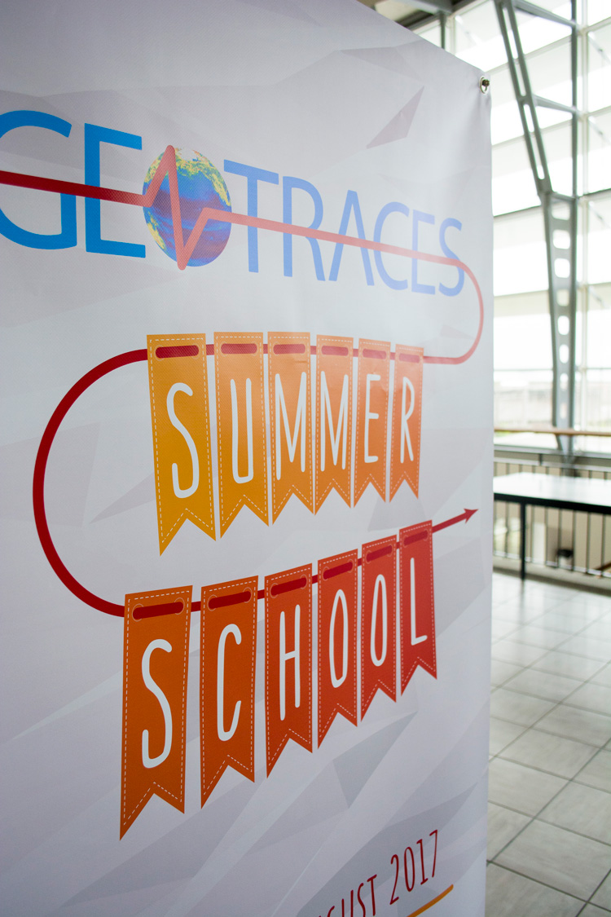
3rd GEOTRACES Summer School planned for 2021
International GEOTRACES Summer School: Introducing Polar Parameters
15 – 21 July 2022 in Bremerhaven, Germany
50 students and 16 lecturers
Course to include:
Lectures
Training in shipboard sampling (RV Heincke)
Lab/computer practicals (ICP-MS analysis, sample processing, sensor mesurements, ODV visualisation)
Organisers: Walter Geibert (AWI), POLMAR Graduate School @AWI (Claudia Hanfland)

Slide 11
GEOTRACES Video for the general public
Animation by Adrian Artis Directed by Catherine Jeandel and Elena Masferrer
Voice by Thomas Boutilier / Thanks to Rogue Elephant
Youtube link: https://youtu.be/FoGnPTpOlCg

Slide 12
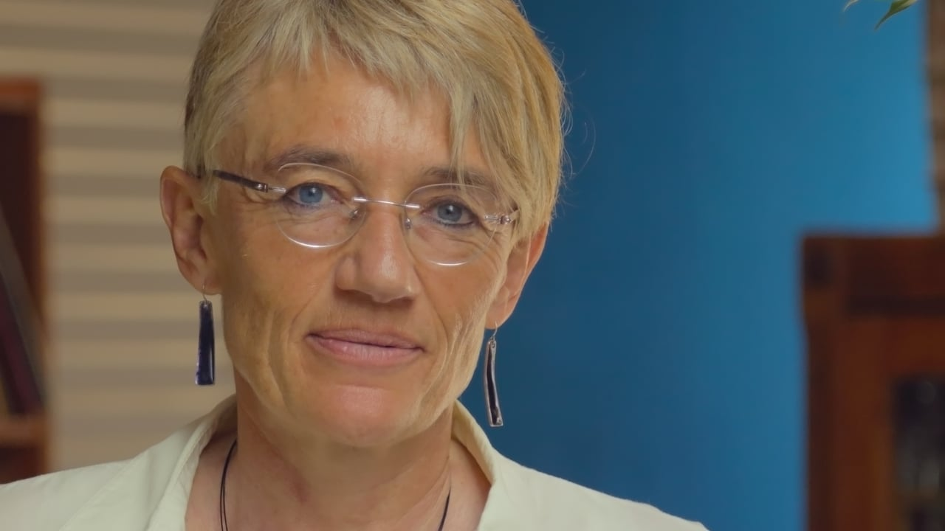
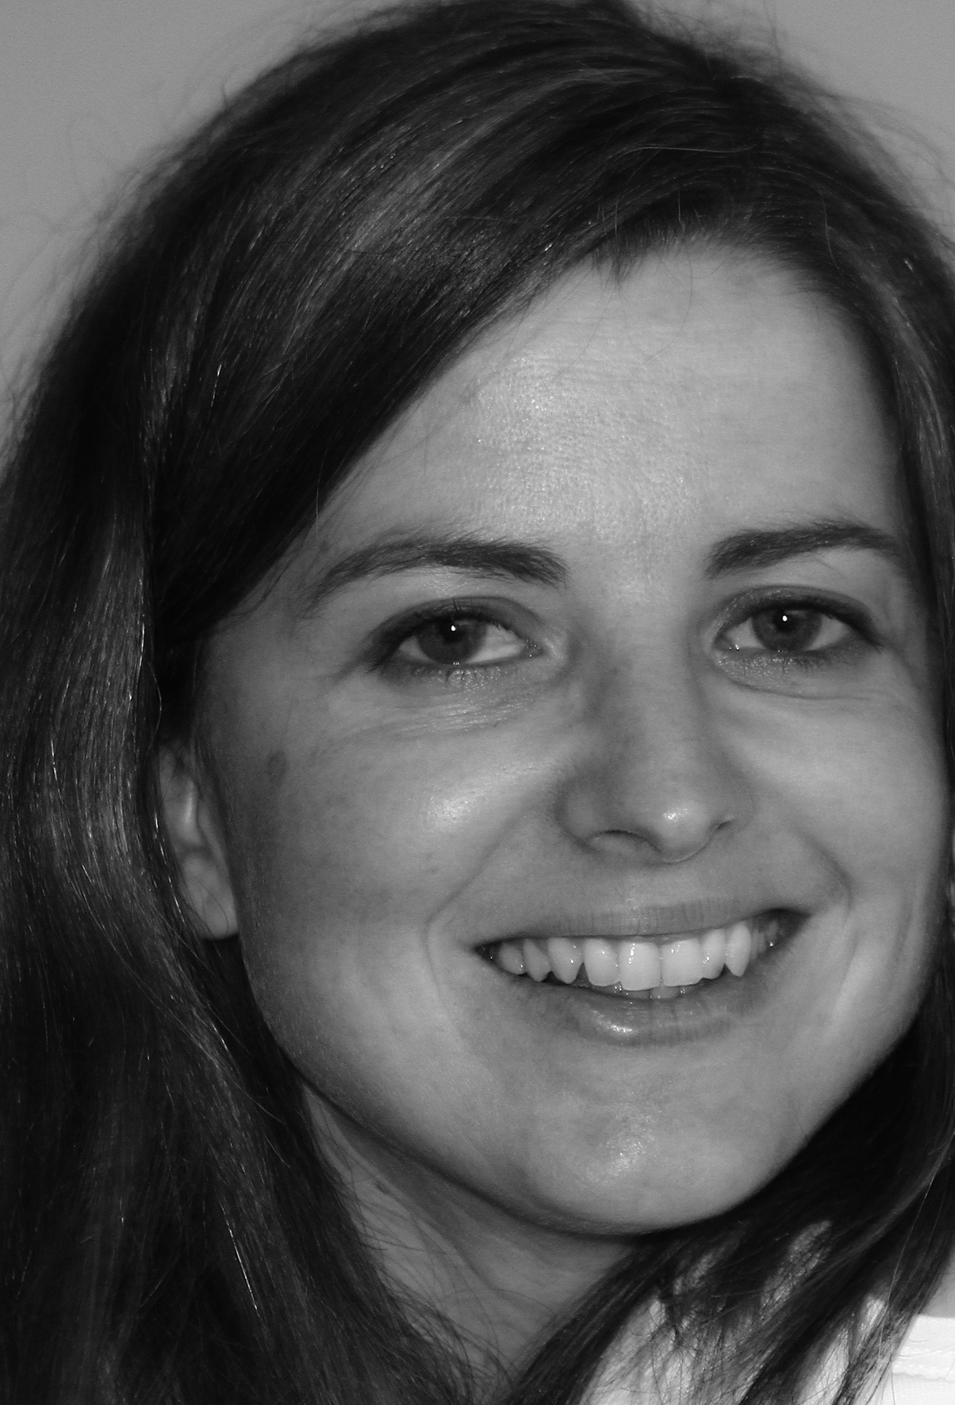
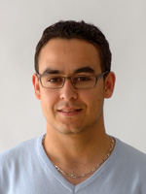
Thank you very much!
Contact us
International Coordination:
GEOTRACES International Project Office (LEGOS-OMP, Toulouse, France)
Catherine Jeandel (Scientific Director)
Elena Masferrer Dodas (Executive Officer) ipo@geotraces.org
Data Management:
Mohamed Adjou (Data Manager)
GEOTRACES Data Assembly Centre (BODC, Liverpool) geotraces.dac@bodc.ac.uk
www.geotraces.org
Subscribe to our eNewsletter and mailing list!

